Slide 1
IS113
Web Application Development I
Week 10
Database Interactions - Mongo DB using Atlas database

Slide 2
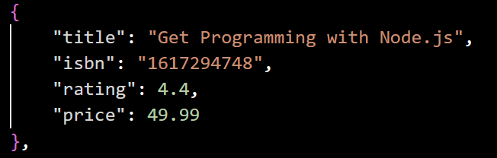
Introduction to MongoDB
What is it?
MongoDB is a document database (also known as a document-oriented database or a document store) is a database that stores information in documents.
Document databases are considered to be non-relational (or NoSQL) databases. Instead of storing data in fixed rows and columns, document databases use flexible documents. Document databases are the most popular alternative to tabular, relational databases.
What is a document?
A document is a record in a document database. A document typically stores information about one object and any of its related metadata. Documents store data in field-value pairs. The values can be a variety of types and structures, including strings, numbers, dates, arrays, or objects. Documents can be stored in formats like JSON, BSON, and XML.
E.g. of a JSON document storing the information about a particular book.
Notes:
Ref: Many parts of this slides are taken from MongoDB, read more about MongoDB in the link below. https://www.mongodb.com/resources/basics/databases/document-databases

Slide 3
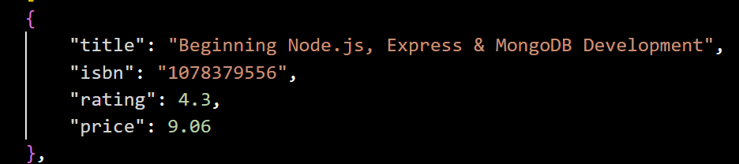
Introduction to MongoDB
What is it?
What is a collection
A collection is a group of documents. Collections typically store documents that have similar contents.
Not all documents in a collection are required to have the same fields, because document databases have flexible schemas. Note that some document databases provide schema validation, so the schema can optionally be locked down when needed.
This document can be a in a collection call books where it can store many other documents of books.
A Collection of Books
Notes:
Ref: Many parts of this slides are taken from MongoDB, read more about MongoDB in the link below. https://www.mongodb.com/resources/basics/databases/document-databases

Slide 4

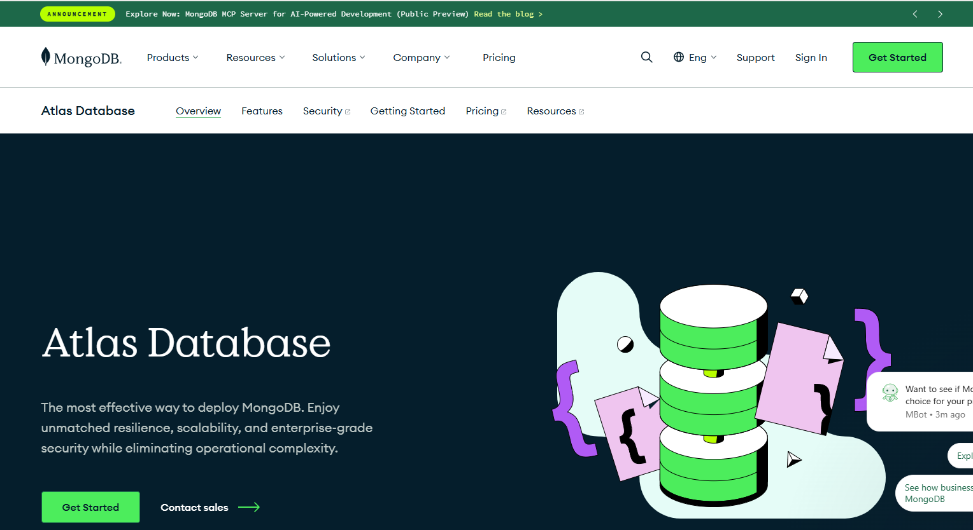
Cloud MongoDB
Sign UP https://www.mongodb.com/products/platform/atlas-database
Do this :
We will be using the cloud version of MongoDB. Go to the link provided.
Click on Get Started.

Slide 5
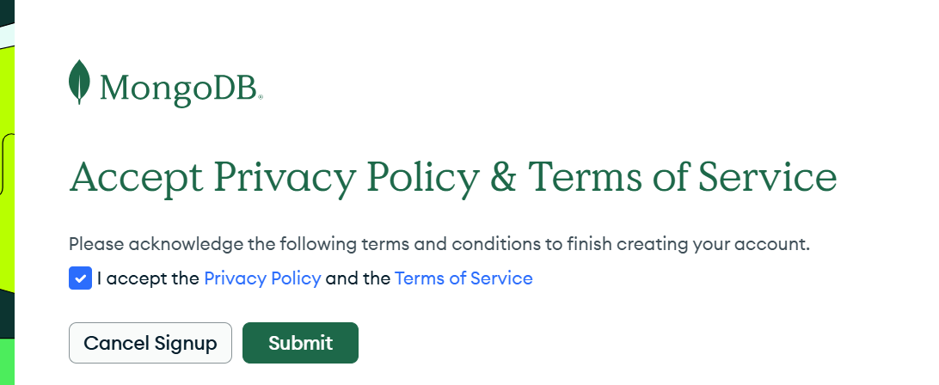
Cloud MongoDB
Accept Privacy Policy
Do this :
Create your own Altas Account or you can use your SMU google account.
Check accept Privacy Policy and click Submit

Slide 6
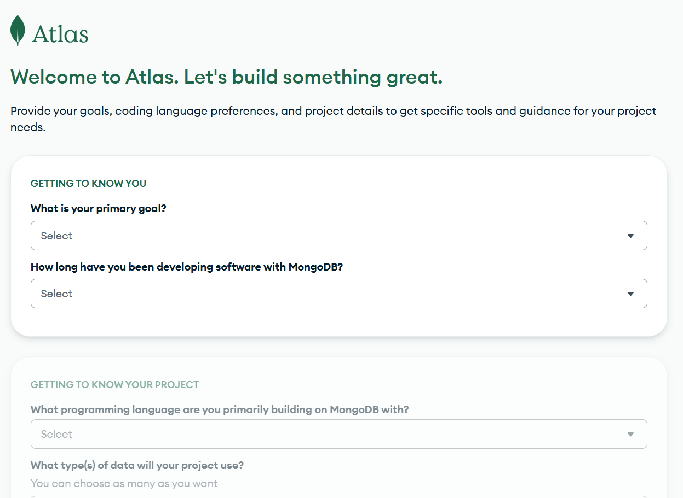
Cloud MongoDB
Fill in your goals and preferences
Do this :
Fill in your goals and preferences.

Slide 7
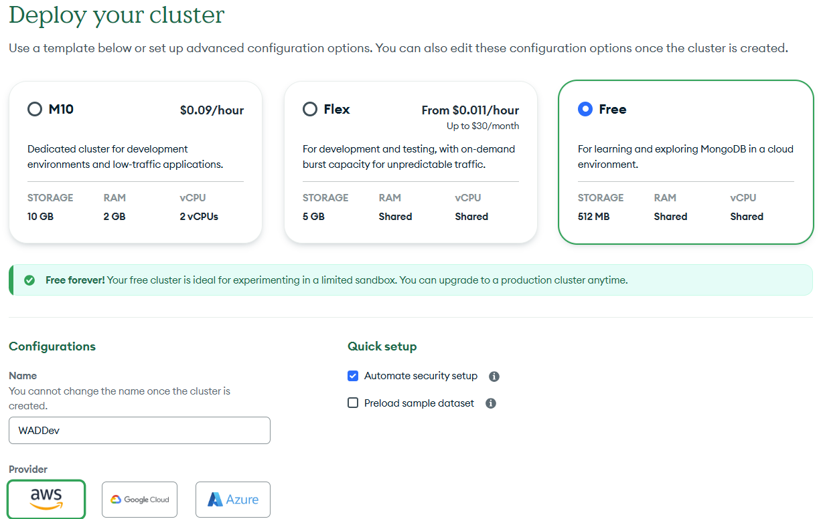
Cloud MongoDB
Create your cluster
Do this :
MongoDB Atlas Cluster* is a Document Database-as-a-Service offering in the public cloud (available in Microsoft Azure, Google Cloud Platform, Amazon Web Services). This is a managed MongoDB service, where with just a few clicks, you can set up a working MongoDB cluster, accessible from your favorite web browser.
Click on the Free Box and Name your cluster.
You will not be able to change the name of the cluster later. Do use a meaningful name.
Choose AWS as default
Uncheck preload sample dataset
Click Create Deployment
It might take some time to create.
Notes:
Ref : MongoDB Atlas Cluster * -- https://www.mongodb.com/resources/products/fundamentals/clusters

Slide 8
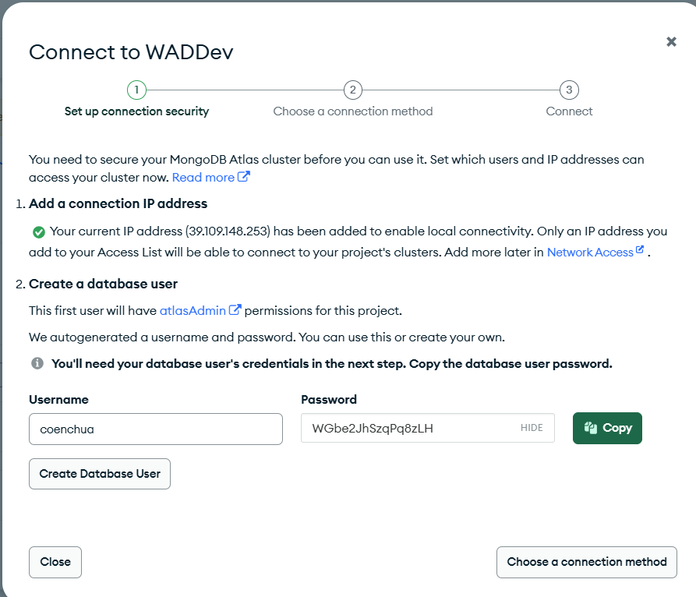
Cloud MongoDB
Create user / connection
Do this :
Create your admin user and create a password.
Please note down your IP, username and password in a digital text file to prevent issues later.
Click Create Database User

Slide 9
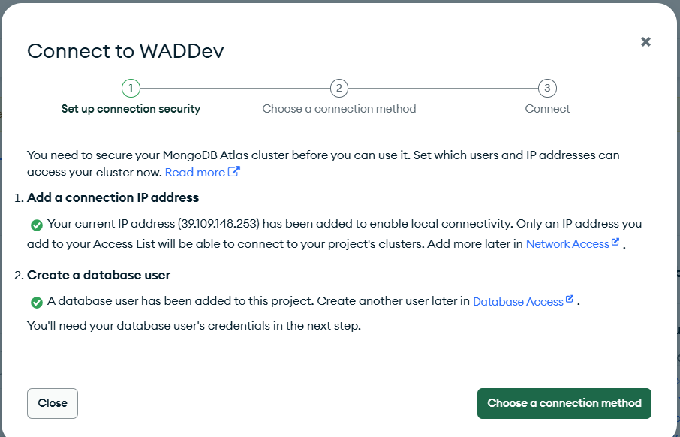
Cloud MongoDB
Create user / connection
Do this :
Click Choose a connection method

Slide 10
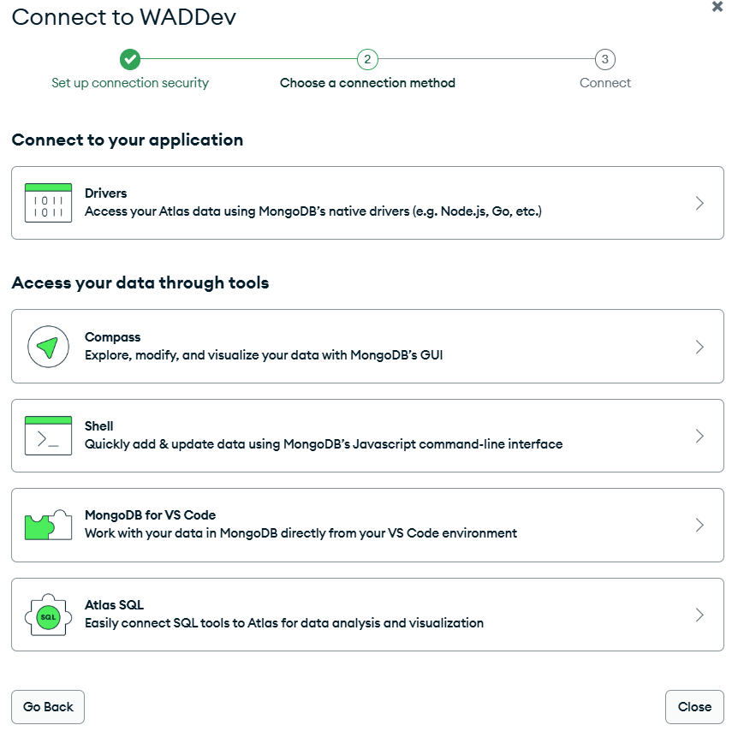
Cloud MongoDB
Select Compass
Do this :
Choose Compass ( MongoDB GUI)

Slide 11
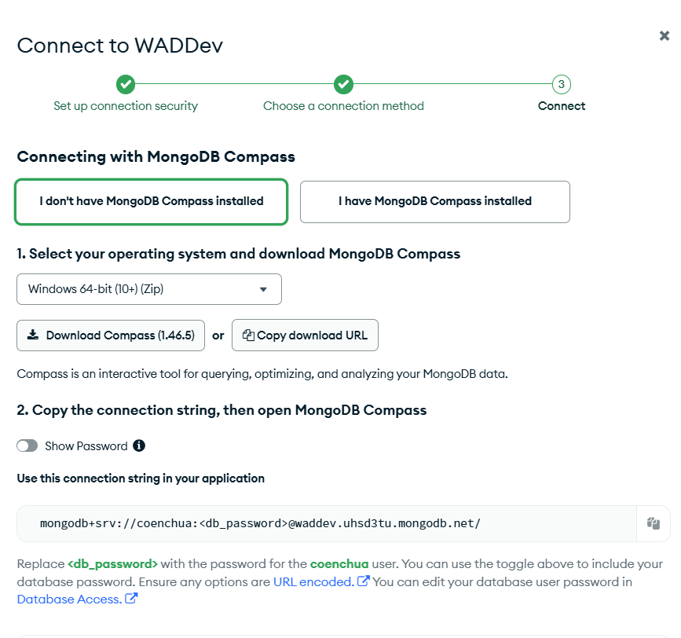
Cloud MongoDB
Connect
Do this :
Choose I don’t have MongoDB Compass installed.
Select your OS system
Copy your USERNAME, PASSWORD and CLUSTERADDRESS and paste it in a text file where you are able to retrieve it.
Ensure that username and password does not contain any special characters.
Click Download Compass and Done.
Retrieve and extract the download file.
Your connection string looks something like this. mongodb+srv://<USERNAME>:<PASSWORD>@<CLUSTERADDRESS>/ Those words highlighted in red will change according to each user.

Slide 12
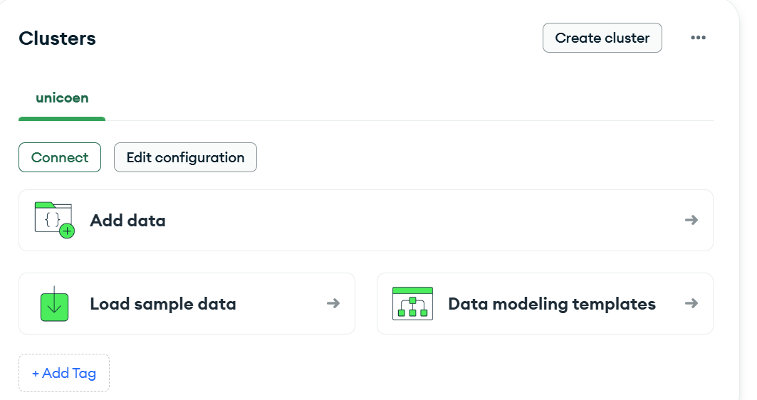
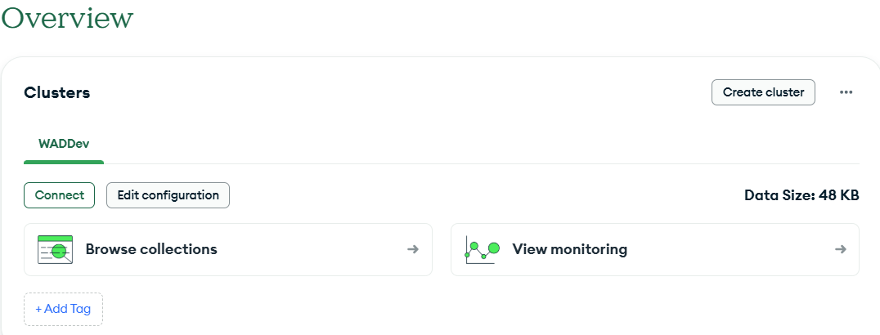
Create a Database using Altas
Let’s try to create a database in our cluster
Do this :
If you are not in overview, Click on Overview on the left sidebar
You will only see Figure 1 if you uncheck the preload sample data. Click Add Data.
If you see Figure 2, click on Browse collections instead.
Figure 1
Figure 2

Slide 13
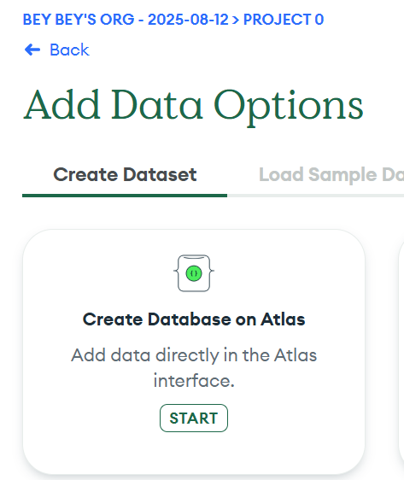
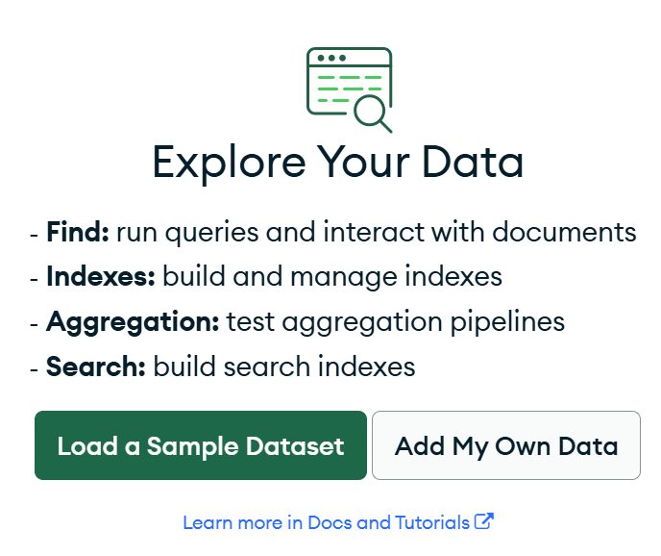
Create a Database using Altas
Add Data
Do this :
There are several different screens for you to add data.
Figures 1 and 2 are two different screens that you may see, depending on your previous selection and if you choose to check or uncheck the preload sample data option.
Should you see any sample collection created by MongoDB, you can drop all of them.
If you see Figure 3, Click on START and if you see Figure 4, click Add My Own Data.
Figure 3
Figure 4

Slide 14
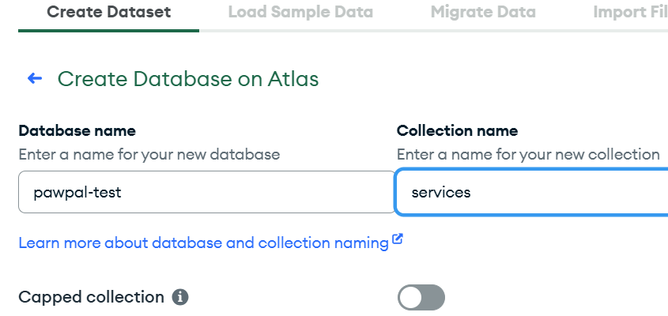
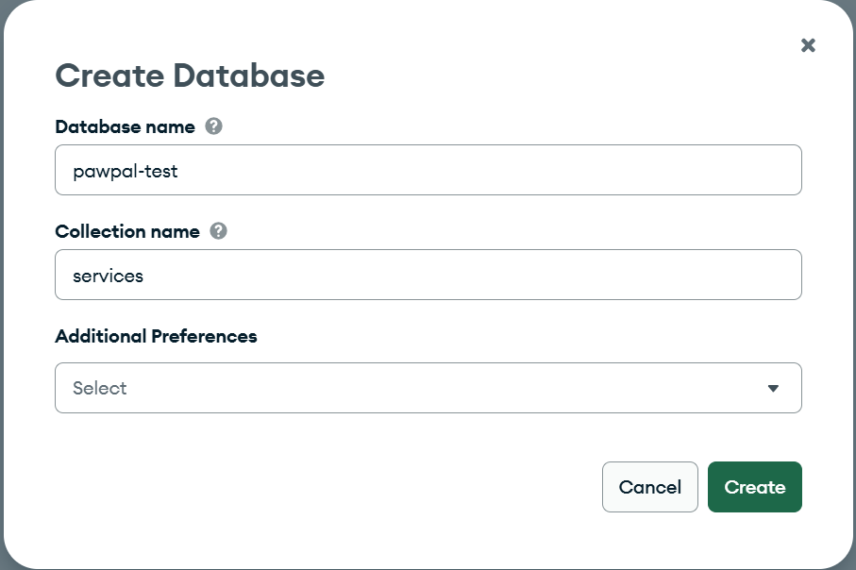
Create a Database using Altas
Add Data
Do this :
Either screen, Figures 5 or 6 will show up depending on the choices you made before.
Enter Database name: pawpal-test
Collection name : services
Click Create. You might have to scroll down in Figure 5 to see the create button.
Figure 5
Figure 6

Slide 15
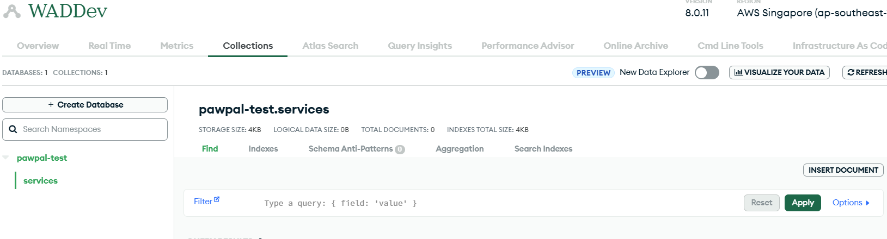
Create a Database using Altas
Add a Document to the collection services
Do this :
Now that we have created the database and collection, let us create a new document.
Click INSERT DOCUMENT

Slide 16
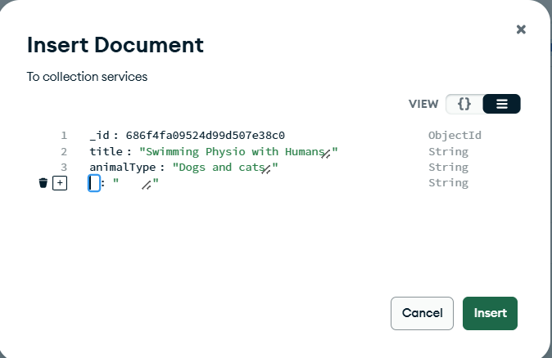
Create a Database using Altas
Add a Document to the collection services
Do this :
You will see a pop-up window.
Click on the + sign to add a new line
Click on the “text-box” to key in the field names and the values

Slide 17
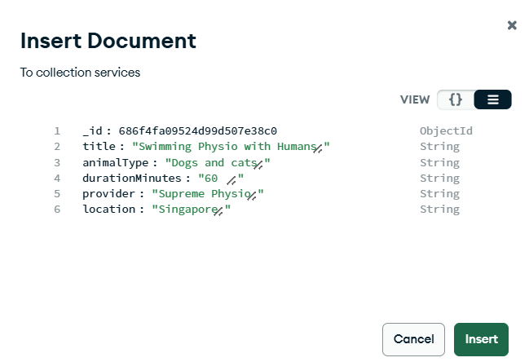
Create a Database using Altas
Add a Document to the collection services
Do this :
key in these field names and their values as shown
Click Insert.

Slide 18
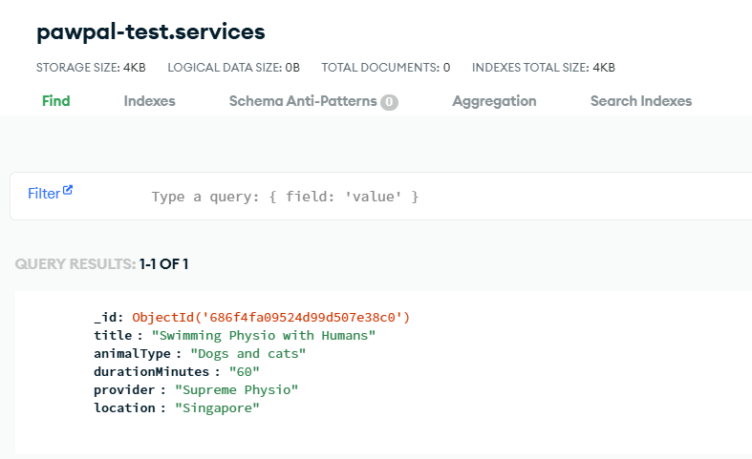
Create a Database using Altas
Add a Document to the collection services
Do this :
You will see the newly inserted document.

Slide 19
What have we learned
In this section, you took your first step toward using a real cloud database by setting up MongoDB Atlas.
You learned how to:
Create a MongoDB Atlas cluster in the cloud
Set up a database and a collection
Insert a document directly through the Atlas UI
This hands-on experience gave you a solid understanding of how MongoDB stores and organizes data in a flexible, document-based structure.
In the next part, we’ll create a new database and connect it to our Express app using Mongoose, and it interact with our data programmatically and build a fully dynamic, cloud-powered backend for our application.

Slide 20
